Slide 1

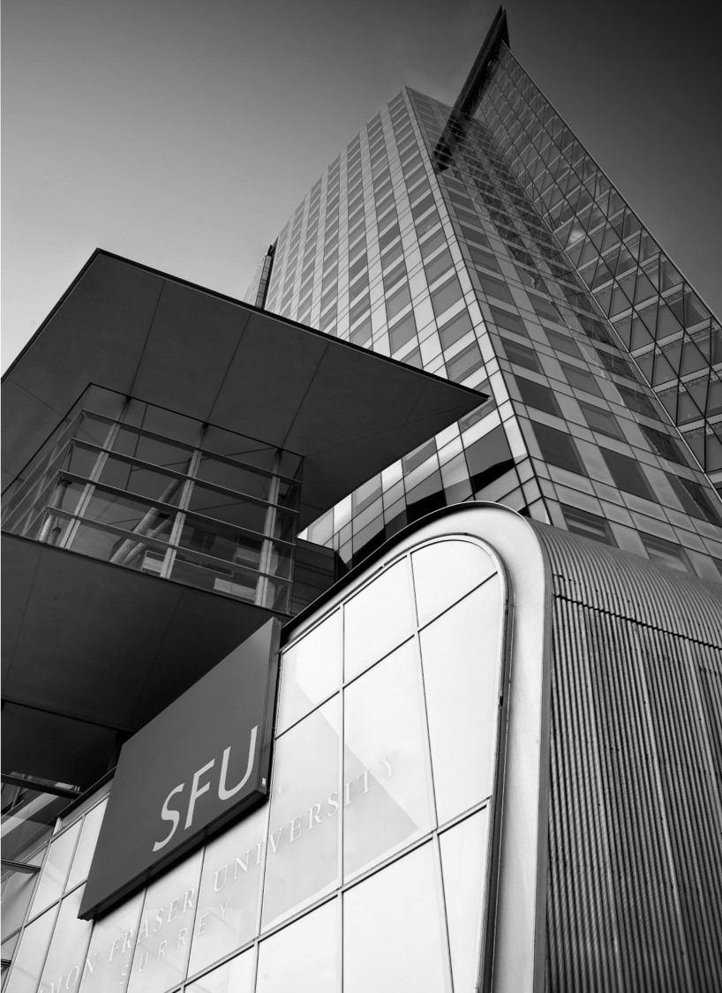
STORYTELLING
MODEL INTERPRETATION
Notes:
HOW TO CHANGE IMAGE:
Click on image box.
Go to “Picture Format” tab
Click “Change Picture”
FONT: Impact, uppercase
Do not extend text outside of red section.
SUBHEADS / DAY MONTH YEAR:
Trebuchet MS, bold, uppercase

Slide 2
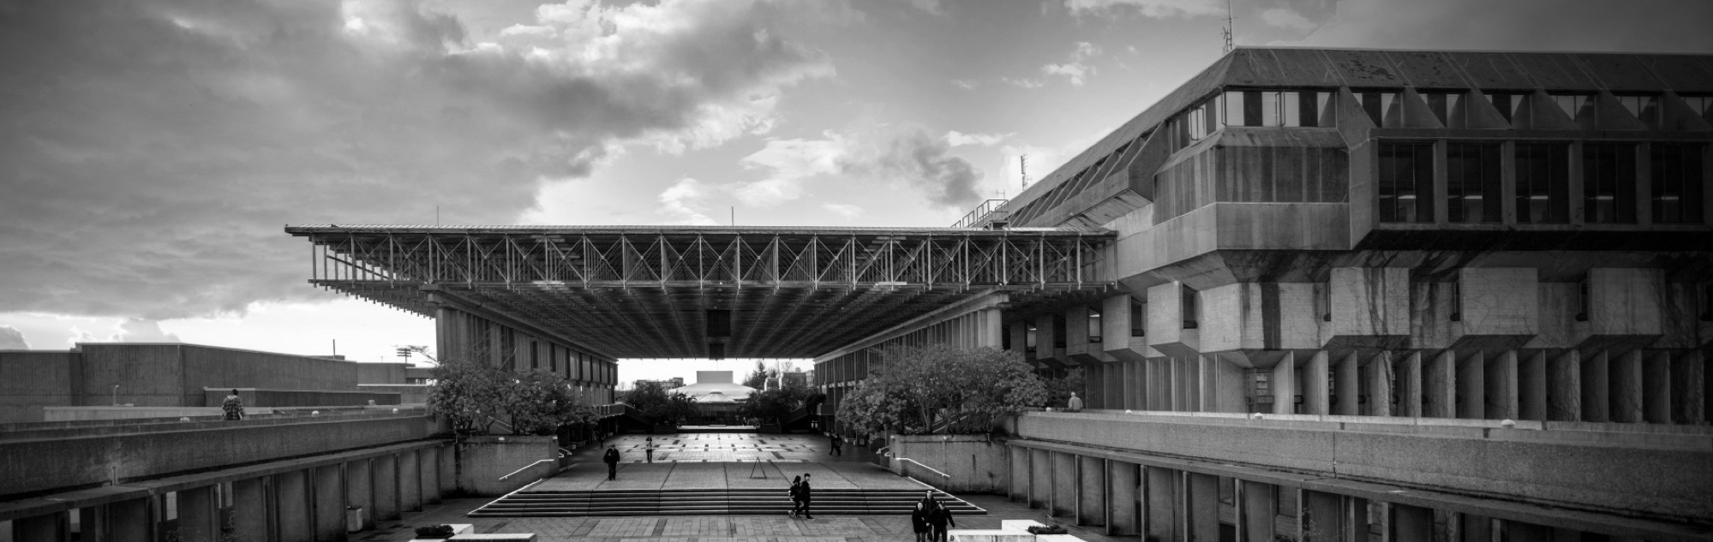
MODEL OUTPUTS
Notes:
HOW TO CHANGE IMAGE:
Click on image box.
Go to “Picture Format” tab
Click “Change Picture”
FONT: Impact, uppercase
Do not extend text outside of red section.
SUBHEADS / DAY MONTH YEAR:
Trebuchet MS, bold, uppercase

Slide 3
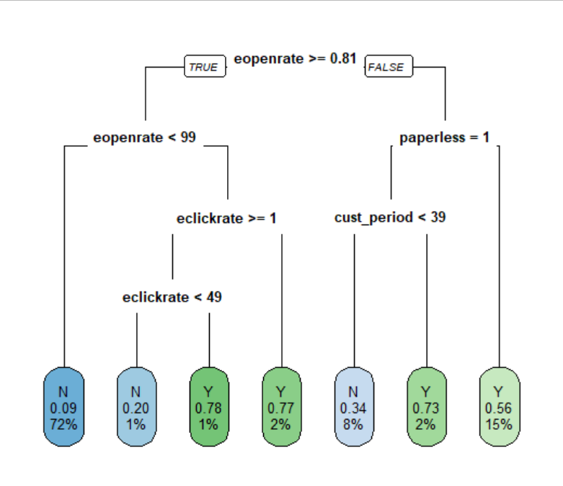
DECISION TREE
Model1.RPart
Notes:
FONT: Header:
Impact, uppercase Subheads and Table: Trebuchet MS, bold, uppercase Body: Times, sentence-case

Slide 4
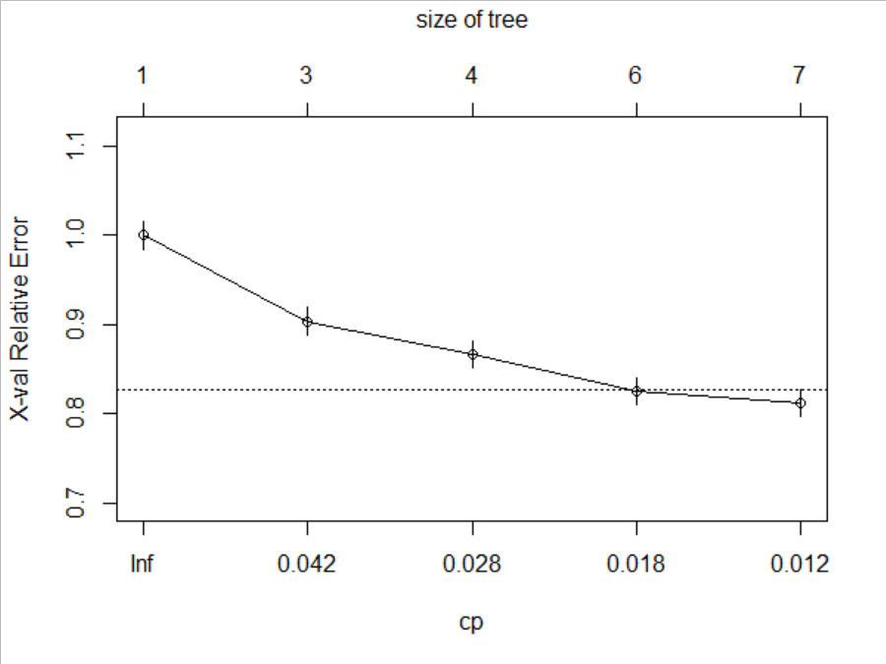
DECISION TREE
0.01 Complexity Parameter
Variables actually used in tree construction: [1] cust_period eclickrate eopenrate paperless Root node error: 3147/15364 = 0.20483 n= 15364 CP nsplit rel error xerror xstd 1 0.048141 0 1.00000 1.00000 0.015896 2 0.037496 2 0.90372 0.90372 0.015297 3 0.020813 3 0.86622 0.86718 0.015054 4 0.015570 5 0.82459 0.82555 0.014764 5 0.010000 6 0.80902 0.81220 0.014668
Notes:
FONT: Header:
Impact, uppercase Subheads and Table: Trebuchet MS, bold, uppercase Body: Times, sentence-case

Slide 5
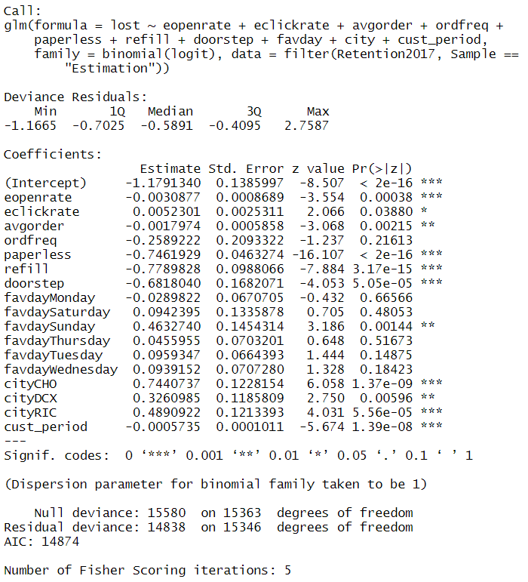
LOGISTIC REGRESSION
Summary
Notes:
FONT: Header:
Impact, uppercase Subheads and Table: Trebuchet MS, bold, uppercase Body: Times, sentence-case

Slide 6
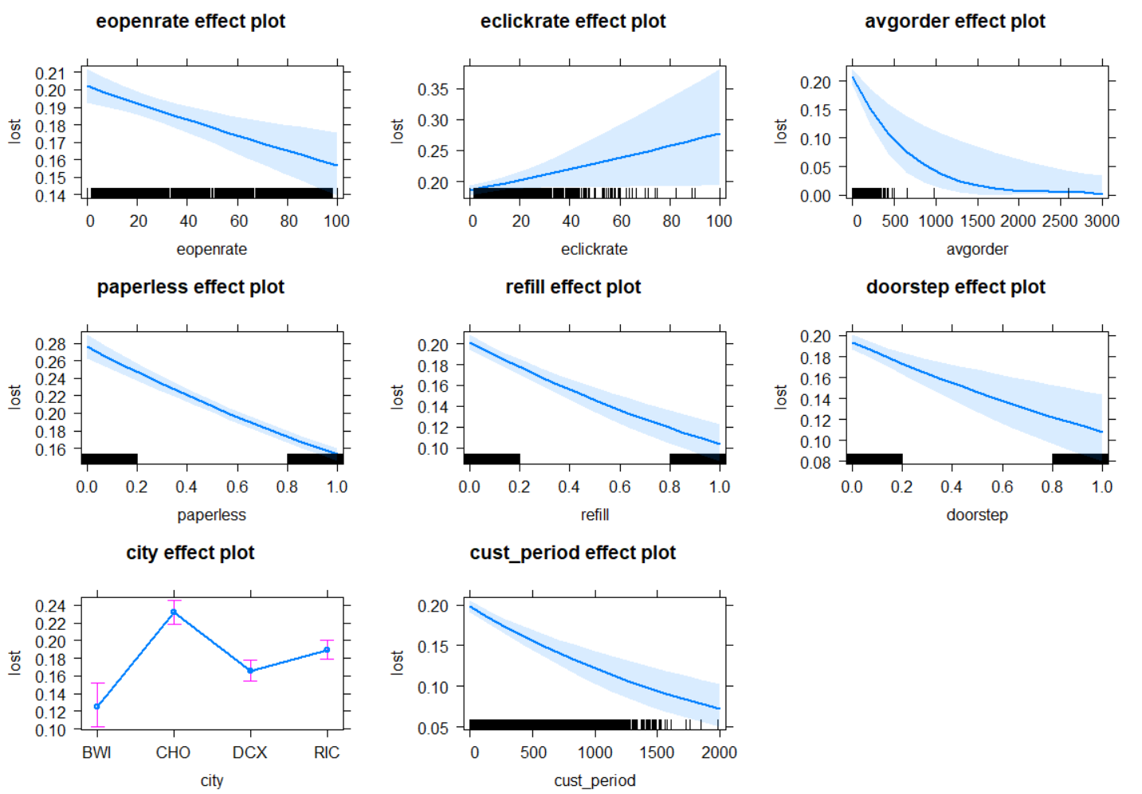
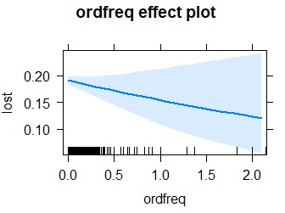
LOGISTIC REGRESSION
Effect Plots
Notes:
FONT: Header:
Impact, uppercase Subheads and Table: Trebuchet MS, bold, uppercase Body: Times, sentence-case

Slide 7
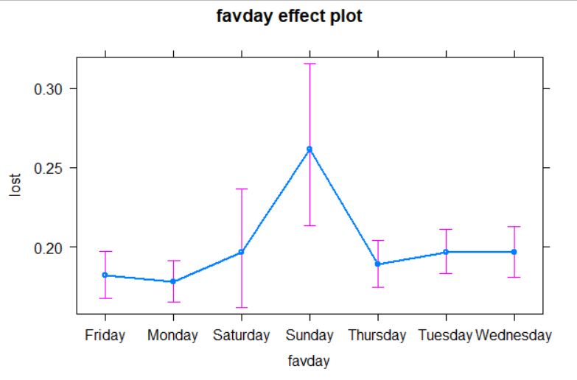
LOGISTIC REGRESSION
Effect Plots Cont.
Notes:
FONT: Header:
Impact, uppercase Subheads and Table: Trebuchet MS, bold, uppercase Body: Times, sentence-case

Slide 8
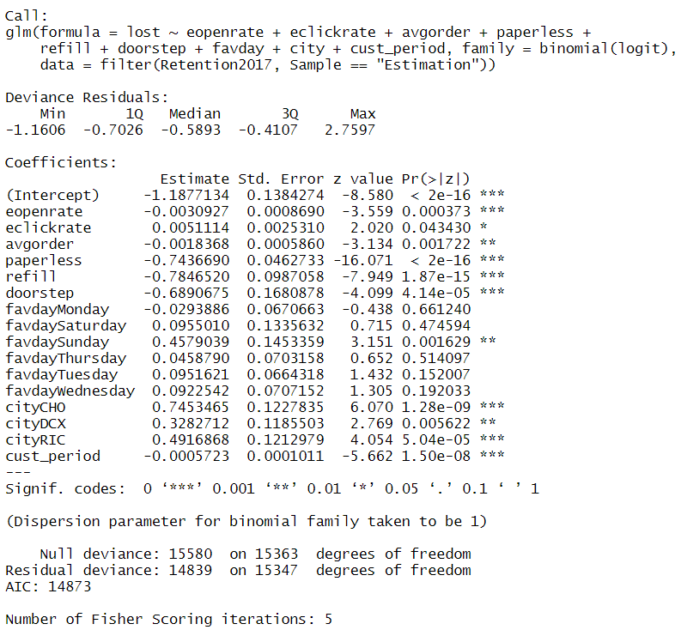
STEPWISE REGRESSION
Summary
Notes:
FONT: Header:
Impact, uppercase Subheads and Table: Trebuchet MS, bold, uppercase Body: Times, sentence-case

Slide 9
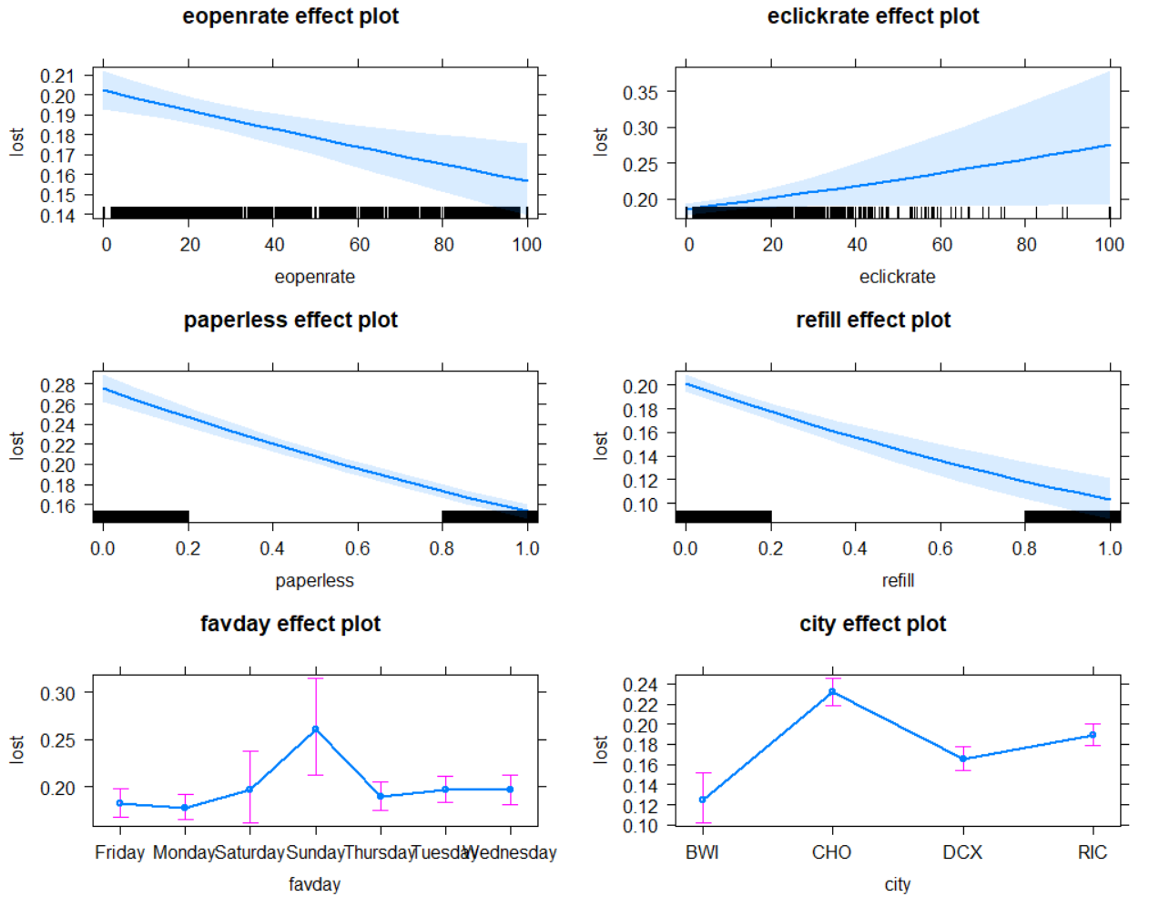
STEPWISE REGRESSION
Effect Plots
Notes:
FONT: Header:
Impact, uppercase Subheads and Table: Trebuchet MS, bold, uppercase Body: Times, sentence-case

Slide 10
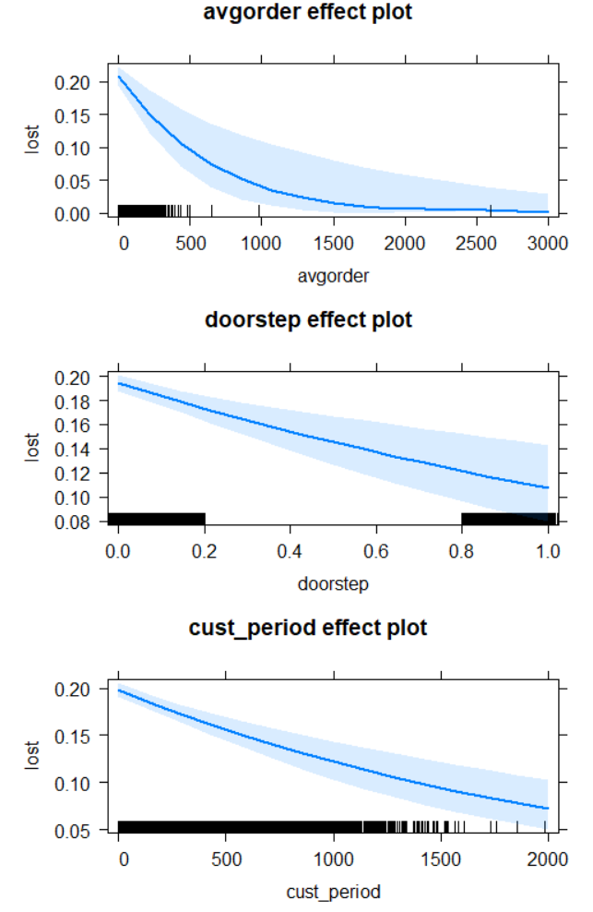
STEPWISE REGRESSION
Effect Plots Cont.
Notes:
FONT: Header:
Impact, uppercase Subheads and Table: Trebuchet MS, bold, uppercase Body: Times, sentence-case

Slide 11
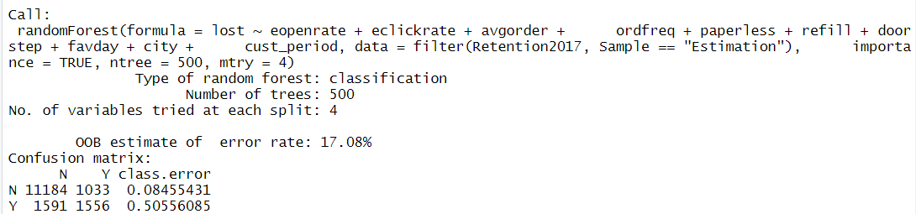
RANDOM FOREST
Summary
Notes:
FONT: Header:
Impact, uppercase Subheads and Table: Trebuchet MS, bold, uppercase Body: Times, sentence-case

Slide 12
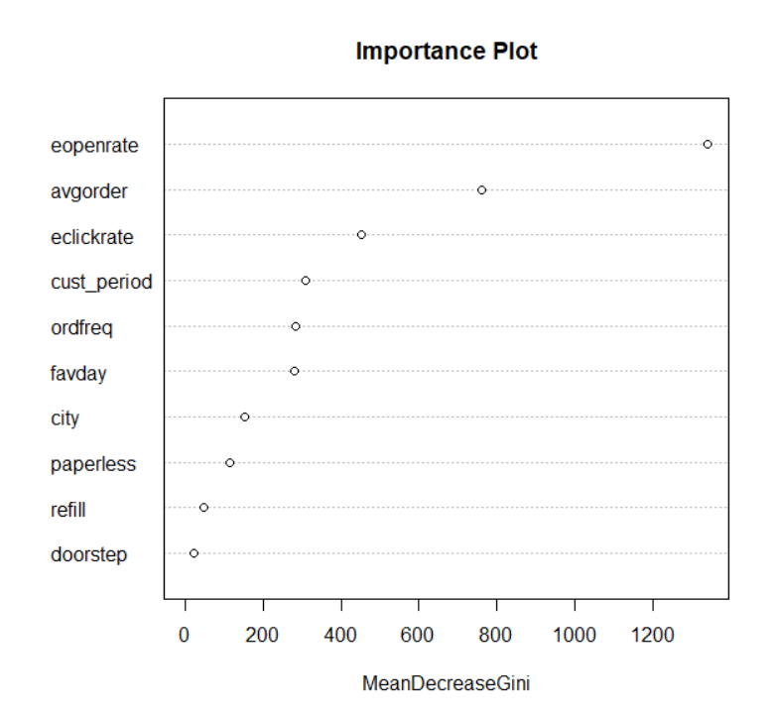
RANDOM FOREST
Importance Plot
Notes:
FONT: Header:
Impact, uppercase Subheads and Table: Trebuchet MS, bold, uppercase Body: Times, sentence-case

Slide 13
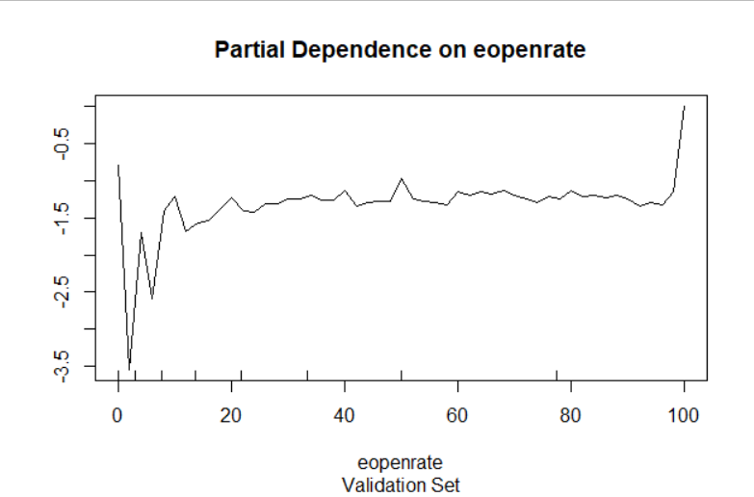
RANDOM FOREST
Partial Dependence Plot
eopenrate
Notes:
FONT: Header:
Impact, uppercase Subheads and Table: Trebuchet MS, bold, uppercase Body: Times, sentence-case

Slide 14
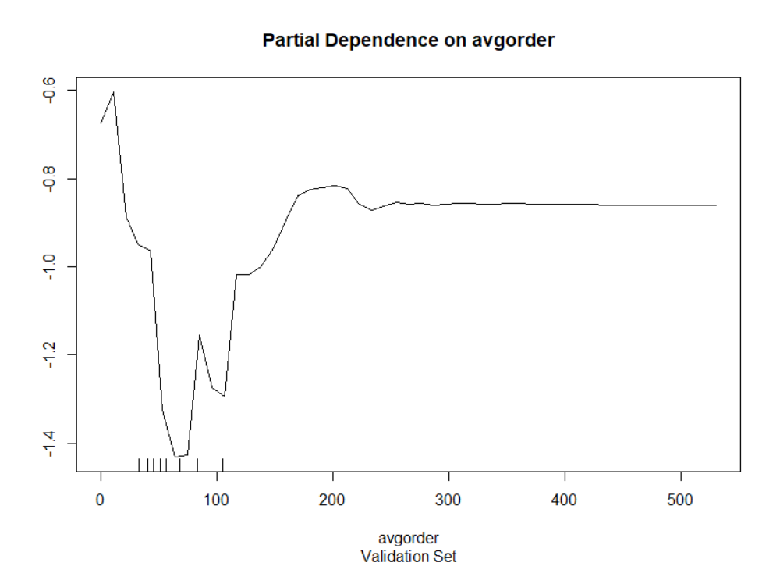
RANDOM FOREST
Partial Dependence Plot
avgorder
Notes:
FONT: Header:
Impact, uppercase Subheads and Table: Trebuchet MS, bold, uppercase Body: Times, sentence-case

Slide 15
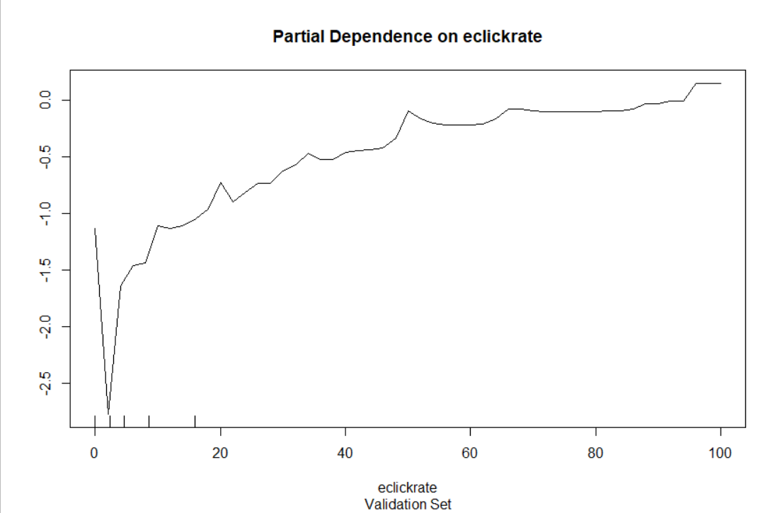
RANDOM FOREST
Partial Dependence Plot
eclickrate
Notes:
FONT: Header:
Impact, uppercase Subheads and Table: Trebuchet MS, bold, uppercase Body: Times, sentence-case

Slide 16
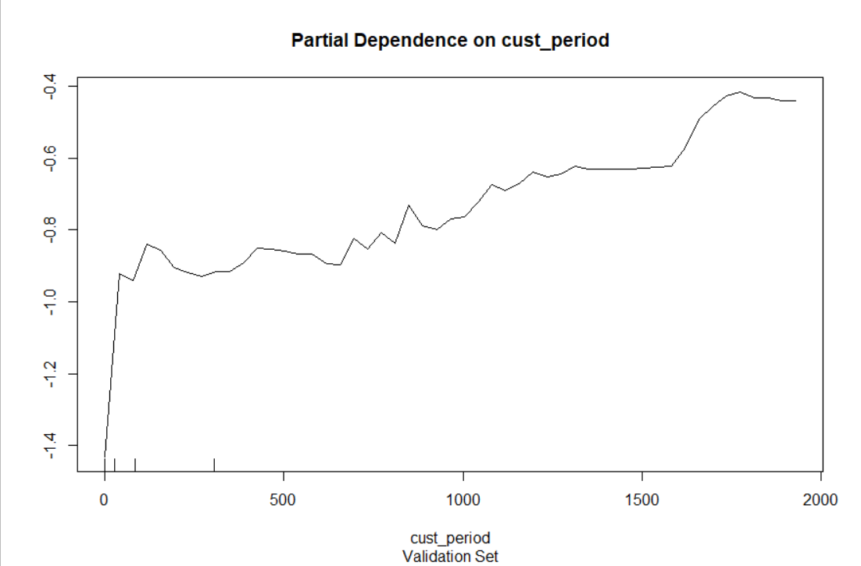
RANDOM FOREST
Partial Dependence Plot
cust_period
Notes:
FONT: Header:
Impact, uppercase Subheads and Table: Trebuchet MS, bold, uppercase Body: Times, sentence-case

Slide 17
LIFT CHARTS
Notes:
HOW TO CHANGE IMAGE:
Click on image box.
Go to “Picture Format” tab
Click “Change Picture”
FONT: Impact, uppercase
Do not extend text outside of red section.
SUBHEADS / DAY MONTH YEAR:
Trebuchet MS, bold, uppercase

Slide 18
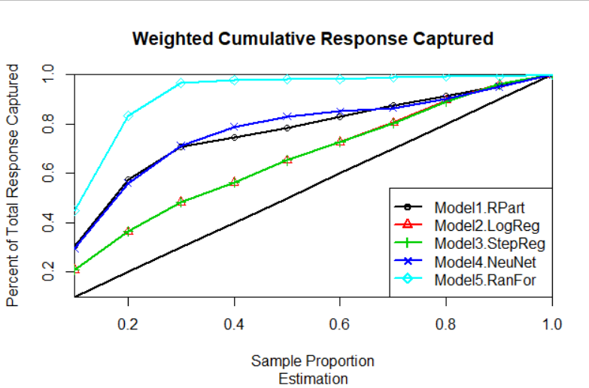
CUMULATIVE LIFT
Estimation
Notes:
FONT: Header:
Impact, uppercase Subheads and Table: Trebuchet MS, bold, uppercase Body: Times, sentence-case

Slide 19
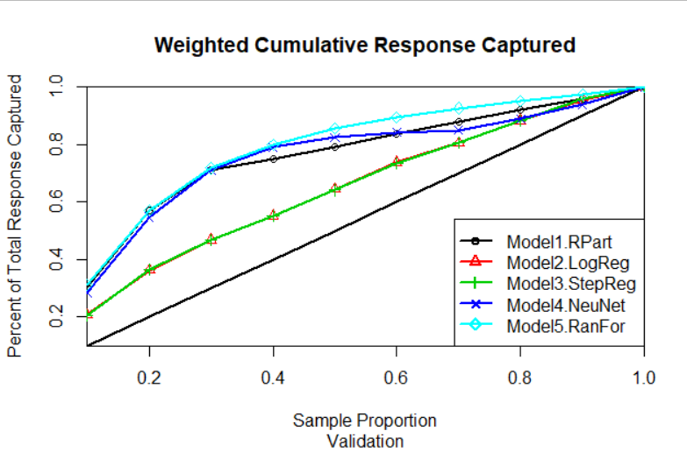
CUMULATIVE LIFT
Validation
Notes:
FONT: Header:
Impact, uppercase Subheads and Table: Trebuchet MS, bold, uppercase Body: Times, sentence-case

Slide 20
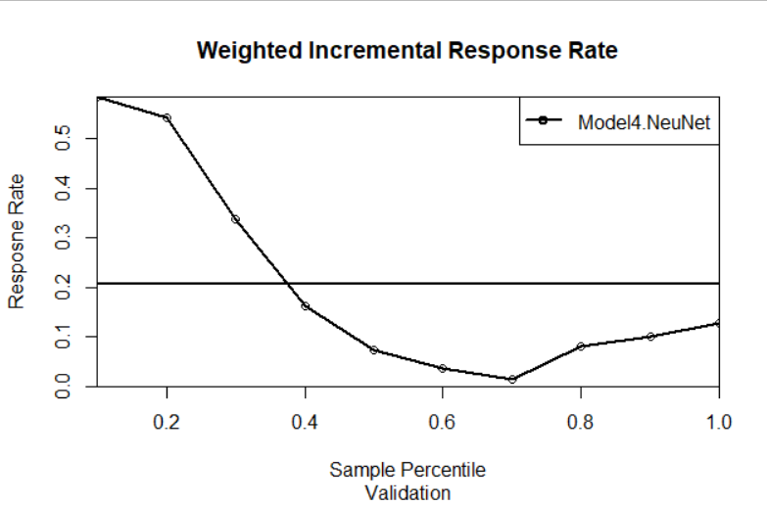
INCREMENTAL LIFT
Neural Network
Validation
Notes:
FONT: Header:
Impact, uppercase Subheads and Table: Trebuchet MS, bold, uppercase Body: Times, sentence-case

Slide 21
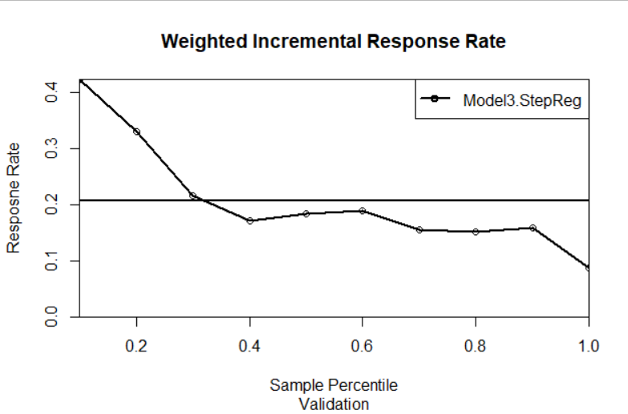
INCREMENTAL LIFT
Stepwise Regression
Validation
Notes:
FONT: Header:
Impact, uppercase Subheads and Table: Trebuchet MS, bold, uppercase Body: Times, sentence-case

Slide 22
PUTTING IT ALL TOGETHER
FINANCIAL IMPACT
Notes:
HOW TO CHANGE IMAGE:
Click on image box.
Go to “Picture Format” tab
Click “Change Picture”
FONT: Impact, uppercase
Do not extend text outside of red section.
SUBHEADS / DAY MONTH YEAR:
Trebuchet MS, bold, uppercase

Slide 23
FINANCIAL IMPACT
custid | avgorder | ordfreq | cust_period | Sample | score | Potential Loss
NF85M6 | 40.02 | 0 | 0 | Holdout | 0.98 | $ 40.02
KL7E2H | 40.02 | 0 | 0 | Holdout | 0.98 | $ 40.02
C56P7B | 40.02 | 0 | 0 | Holdout | 0.98 | $ 40.02
9JMNAX | 40.02 | 0 | 0 | Holdout | 0.98 | $ 40.02
2C8YQT | 40.02 | 0 | 0 | Holdout | 0.98 | $ 40.02
7XP45K | 14.63 | 0 | 0 | Holdout | 0.974 | $ 14.63
P5MSYK | 74.66 | 0.018480493 | 487 | Holdout | 0.864 | $ 671.94
46V8DD | 35.29 | 0.004413063 | 1133 | Holdout | 0.862 | $ 176.45
VC3DLQ | 15.95 | 0.578947368 | 19 | Holdout | 0.86 | $ 175.45
JS7YEU | 103.28 | 0.012820513 | 546 | Holdout | 0.858 | $ 722.96
QXZWPL | 203.55 | 0.032085561 | 187 | Holdout | 0.858 | $ 1,221.30
NW87UP | 58.38 | 0.081632653 | 49 | Holdout | 0.848 | $ 233.52
8NAKCE | 117.66 | 0.011644833 | 687 | Holdout | 0.844 | $ 941.28
SAC5P6 | 93.87 | 0.022288262 | 673 | Holdout | 0.844 | $ 1,408.05
FAS9W3 | 25.63 | 0.013793103 | 145 | Holdout | 0.844 | $ 51.26
HTSXKU | 88.04 | 0.033613445 | 119 | Holdout | 0.842 | $ 352.16
 |  |  |  |  | Total | $ 6,169.10
Loss per order if churn
Potential Loss = Average Order x Order Frequency x Customer Period
Or if order frequency is 0
Potential Loss = Average Order
Notes:
FONT: Header:
Impact, uppercase Subheads and Table: Trebuchet MS, bold, uppercase Body: Times, sentence-case

